Slide 1

PERSONALITY PREDICTION
SEP 788 – NEURAL NETWORKS AND DEVELOPMENT TOOLS
Submitted by:
Arshdeep Singh- ID 400328272
Kunal Garg- ID 400387739

Slide 2
ABOUT THE DATASET
The Myers Briggs Type Indicator (or MBTI for short) is a personality type system that divides everyone into 16 distinct personality types across 4 axis:
Introversion (I) – Extroversion (E)
Intuition (N) – Sensing (S)
Thinking (T) – Feeling (F)
Judging (J) – Perceiving (P)
There are 2 columns (posts and personality type) and over 8600 rows of data:
The first column contains a section of the last 50 Facebook things they have posted (Each entry separated by "|||" (3 pipe characters))
The second column is the Personality Type (This person’s 4 letter MBTI code)

Slide 3
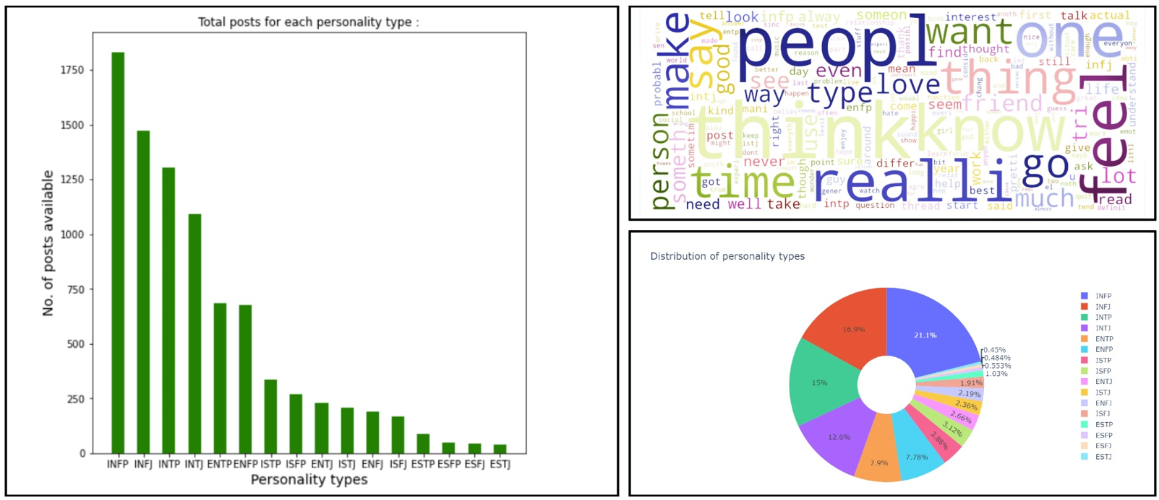
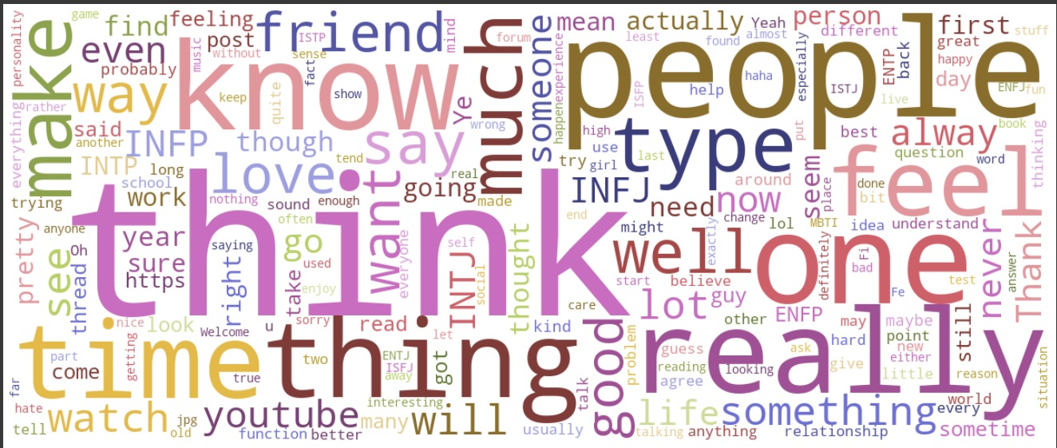
VISUALISATION OF DATA

Slide 4
DATA PRE-PROCESSING
The data set which is in a raw format needs to be cleaned and redundancies need to be removed before we can use it on our models.
Pre-processing of data involves various steps:
Removing duplicates
Expanding the contractions
Lower-casing
Removing stopwords using nltk module
Removing the URLs
Removing punctuations
Removing numbers/digits
Stemming and Lemmatization using nltk module

Slide 5
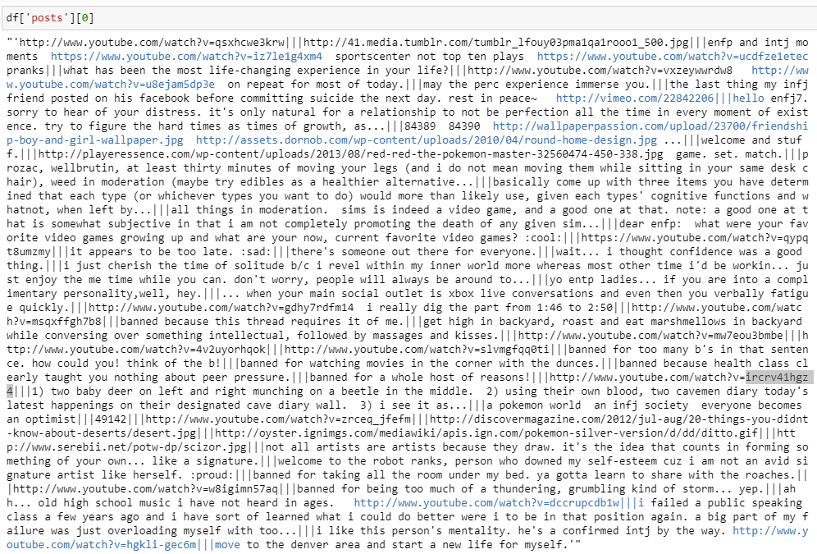
First Data Point Before Pre-Processing

Slide 6
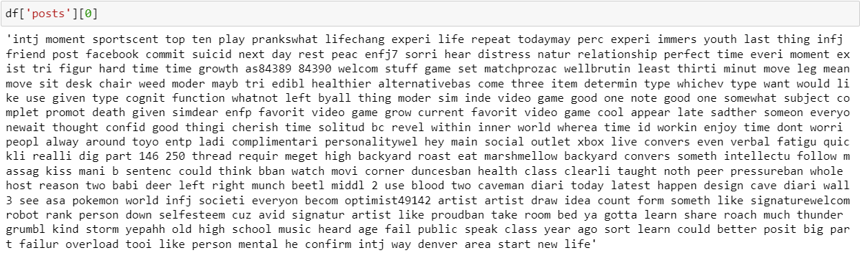
First Data Point After Pre-Processing

Slide 7
TOKENIZATION AND VECTORIZATION
TOKENIZATION: Tokenization is the process of tokenizing or splitting a string, or text into a list of tokens. One can think of tokens as parts like a word is a token in a sentence, and a sentence is a token in a paragraph.
VECTORIZATION: For performing Machine Learning on text, we need to transform our documents into Vector Representations such that we can apply Numeric Machine Learning. This process is called Feature Extraction or more simply, VECTORIZATION.
Each property of the Vector Representation is a FEATURE.
We must now make a critical shift in how we think about language—from a sequence of words to points that occupy a high-dimensional semantic space.

Slide 8


CLASSICAL MACHINE LEARNING MODELS USED
RANDOM FOREST, SVM AND XGBOOST
37.12%
RANDOM
FOREST
56.89%
SVM
63.86%
XGBoost

Slide 9
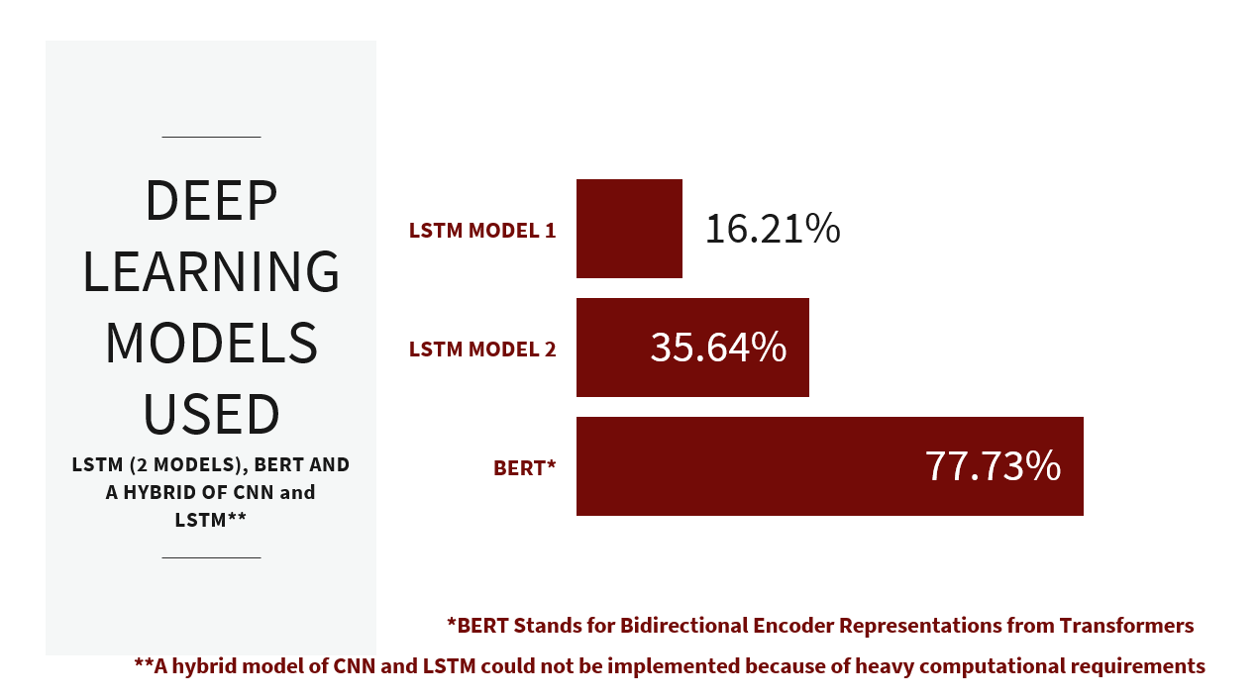

Slide 10
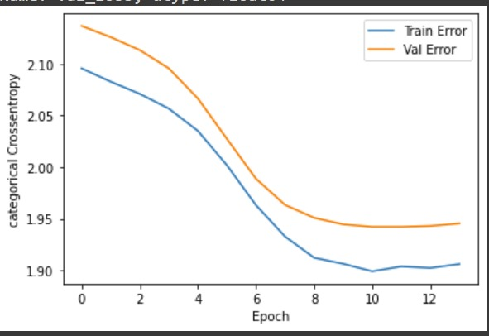
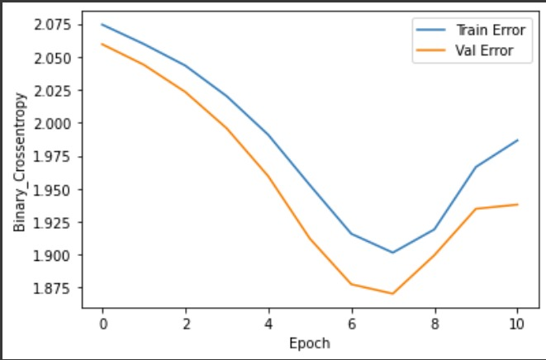
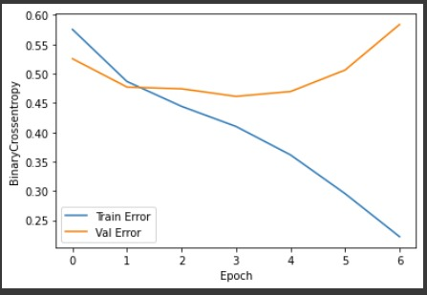
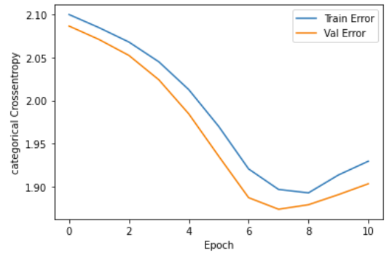
GRAPH OF TRAIN ERROR VS VAL ERROR
LSTM MODEL 1
LSTM MODEL 2
BERT

Slide 11
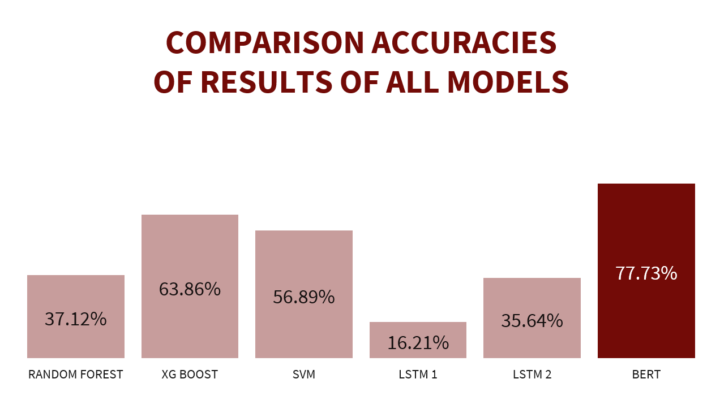

Slide 12
CONCLUSION
1
Among the Deep Learning Models, BERT is the most efficient model in terms of accuracy. However, the computational cost is extremely high
4
Among the classical models, XGBoost gave the best results (63.86%)
5
Classical ML models require much less computational resources and time to be executed completely
2
The computational cost of implementing the deep learning models is very high. It becomes inevitable to use GPUs after a certain point
6
While handling language data, preprocessing becomes an integral step and should be taken care of well
3
7
Hyper-parameters play a major role in DL models and must be tuned carefully
Although BERT outperformed all other models, the classical ML models gave a much better accuracy than LSTM

Slide 13
FUTURE SCOPE OF IMPROVEMENT
1
Since this is dataset contains a diverse range of social media posts and requires the usage of diverse modules such as NLP, and TensorFlow among others, we can test and tune a lot more hyperparameters to obtain higher accuracy
3
Other similar datasets containing personality traits can be used for classification
4
The work can be extended by classifying images posted by users in addition to their social media posts to get a more accurate idea about their personalities
2
Hybrid models such as CNN+LSTM, CNN+BiLSTM, etc can also be implemented on this dataset with adequate computational resources

Slide 14

THANK YOU!
QUESTIONS AND FEEDBACK

